Slide 1

Lina Botero, Brendan Brady

Slide 2
Notes:
As soon as you run the script as shown above, a local Streamlit server will spin up and your app will open in a new tab in your default web browser. The app is your canvas, where you'll draw charts, text, widgets, tables, and more.

Slide 3
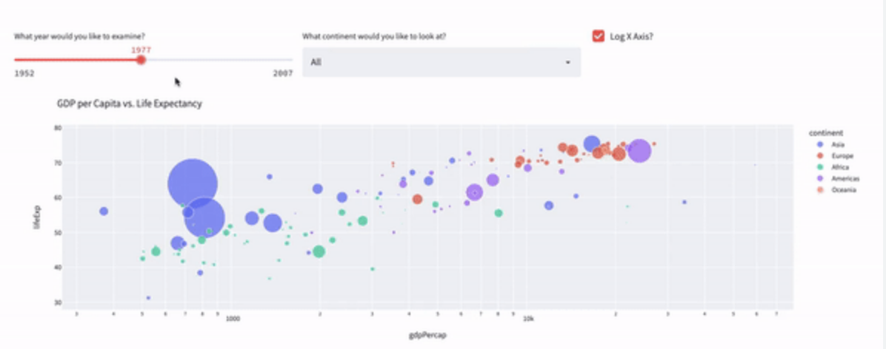
What is Streamlit?
Streamlit is a Python library for building web applications quickly and easily.
How it works:
Write a Python script, importing Streamlit.
Use Streamlit's functions to write data, plot charts, or use widgets.
Run the script, and Streamlit turns it into a web app.
Interact with the app in your browser, with changes updated in real-time.
Notes:
Streamlit is a powerful Python library designed to simplify the process of building web apps. With its intuitive syntax and seamless integration with popular data science libraries, Streamlit empowers developers and data scientists to create interactive and visually appealing applications with ease. Whether you're visualizing data, prototyping machine learning models, or building dashboards, Streamlit provides a streamlined development experience, allowing you to focus on your ideas rather than the complexities of web development. Let's dive in and explore the world of Streamlit!

Slide 4
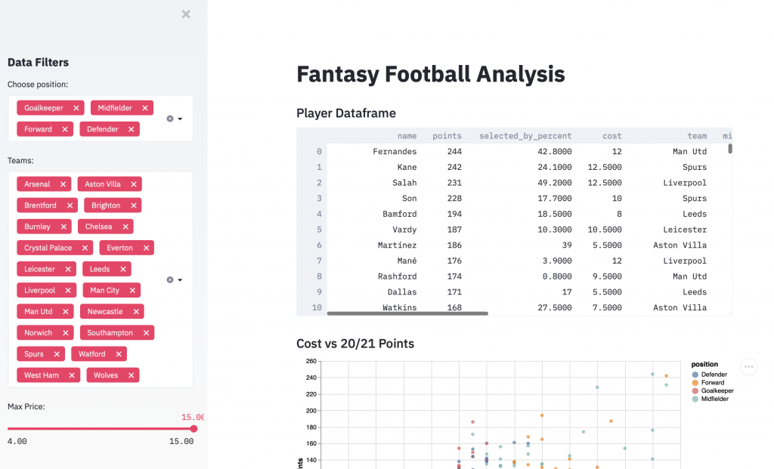
Why would a Data Scientist use Streamlit?
Streamlit is the fastest way to make data apps. Helps you build web applications to be used for sharing analytical results, building complex interactive experiences, and iterating on top of new machine learning models. On top of that, developing and deploying Streamlit apps is fast and flexible, often reducing the application development time from days to hours.
Key Features:
Simple and intuitive syntax
Rapid prototyping of web applications
Data Science Focused
Built-in support for widgets and interactive elements
Easy sharing of apps.
Automatic hot reloading for instant feedback during development
No front-end (html, js, css) experience or knowledge is required
Notes:
Data Visualization: Quick and interactive visualization of data sets, with support for various plotting libraries.
Model Demonstration: Easily demonstrate the workings of machine learning models, allowing for interactive inputs and displaying outputs.
Data Exploration: Create tools for exploring data, filtering, and slicing to uncover insights.
Dashboard Creation: Build custom dashboards for monitoring data, models, or metrics important in data science projects.
Collaboration and Presentation: Streamlit apps can be a powerful tool for sharing insights and analyses with non-technical stakeholders.

Slide 5
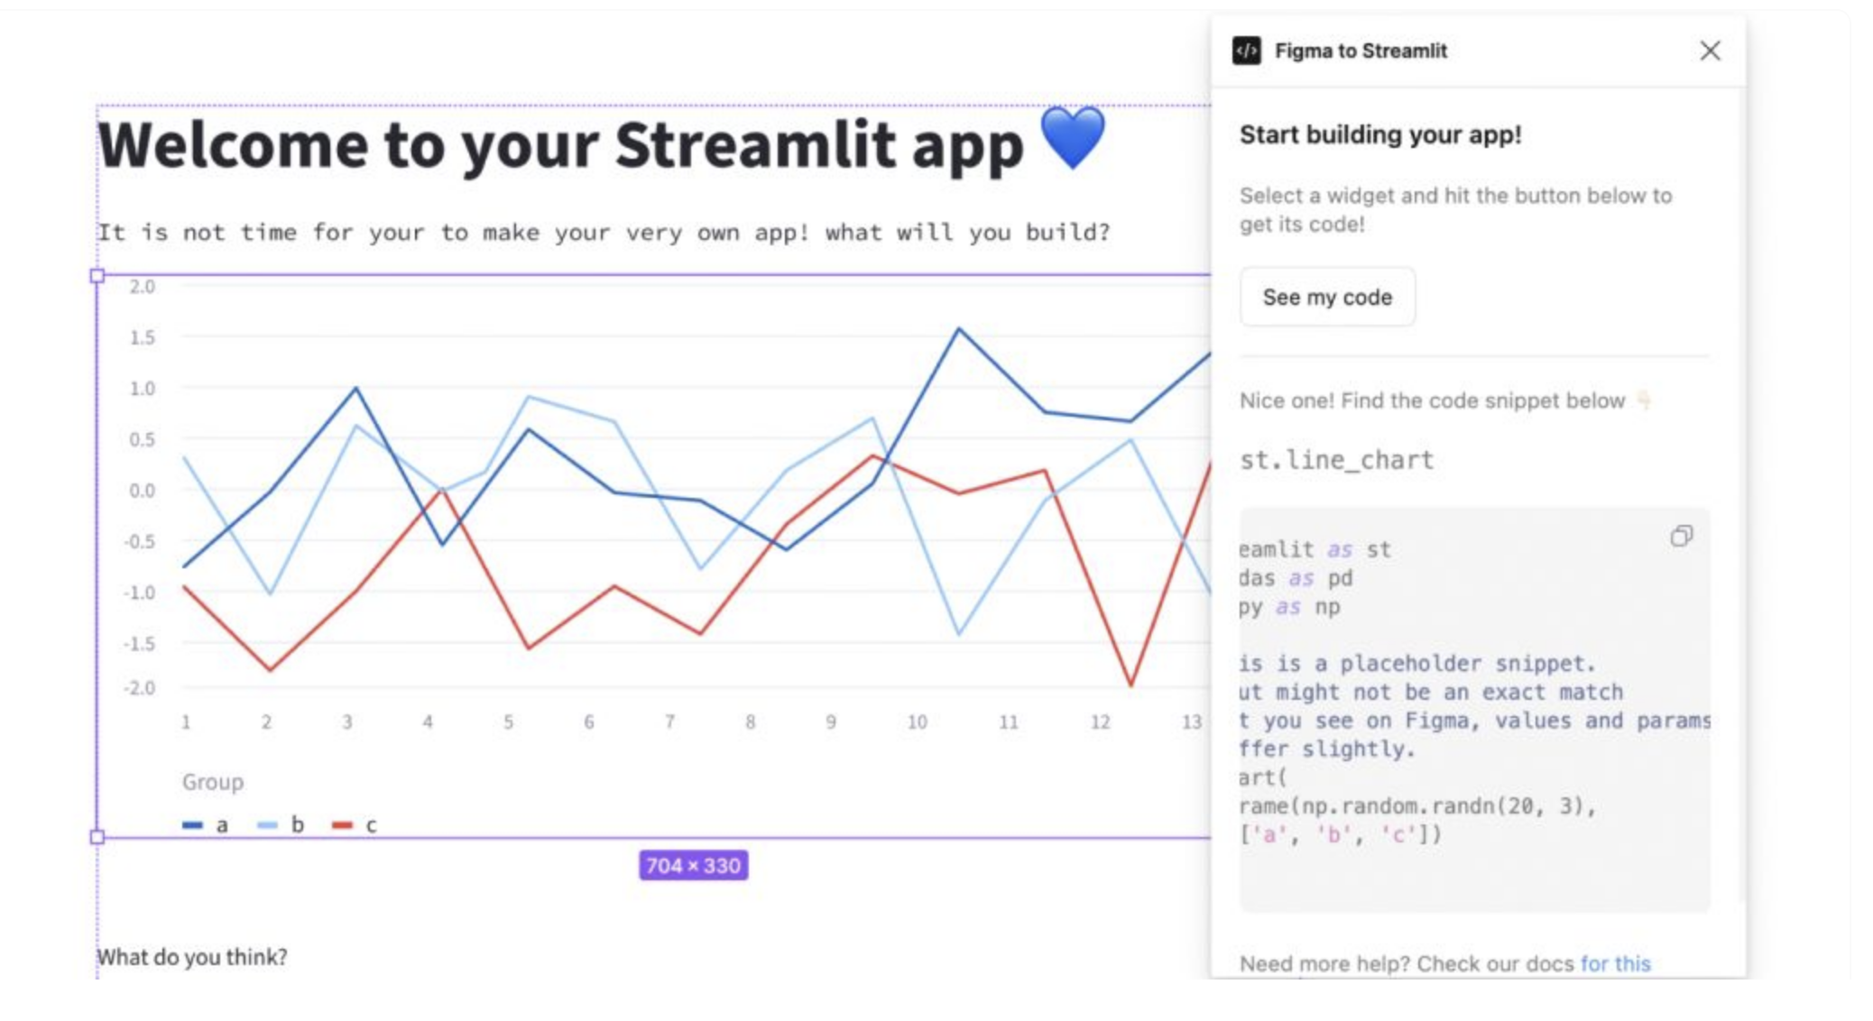
Capabilities and Integrations
Overview of what you can do with Streamlit:
Create interactive web-based data visualizations
Build custom user interfaces for machine learning models and data analysis tools
Develop dashboards for data exploration and presentation
Deploy applications easily to share with others
Streamlit integrates with popular Python libraries:​
Pandas for data manipulation and analysis​
Matplotlib and Seaborn for data visualization​
TensorFlow and PyTorch for machine learning​
​
​

Slide 6
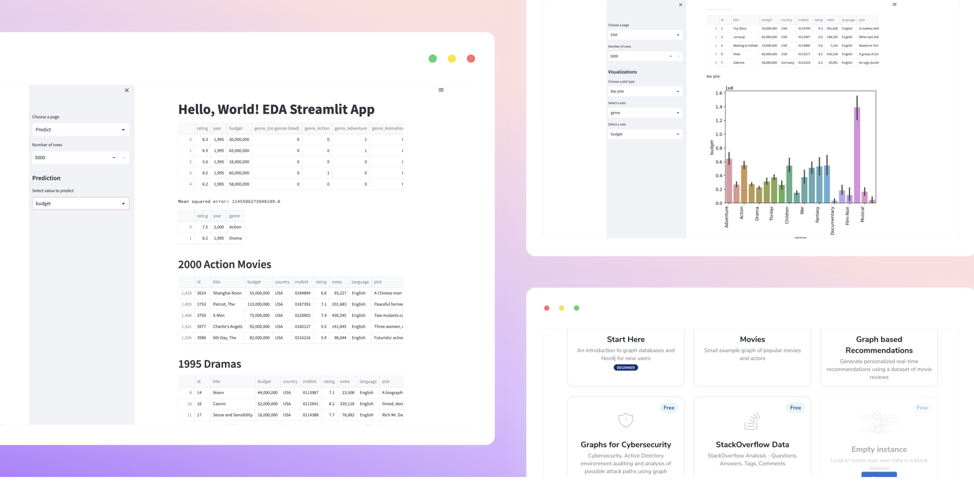
Best practices and Tips
Tips for using Streamlit effectively:
Keep your code modular and organized
Use caching to optimize performance
Leverage Streamlit's layout options for better presentation
Notes:
Code snippet illustrating how to load and display a Pandas DataFrame:
import streamlit as st
import pandas as pd
# Load sample DataFrame
df = pd.read_csv("https://raw.githubusercontent.com/datasciencedojo/datasets/master/titanic.csv")
# Display DataFrame
st.dataframe(df.head())
Code snippet showcasing the use of caching for expensive computations:
@st.cache
def expensive_computation():
# Simulate an expensive computation
time.sleep(5)
return 42
result = expensive_computation()
st.write("Result:", result)
Code snippet demonstrating how to create a slider widget and use it to dynamically update a plot:
import streamlit as st
import matplotlib.pyplot as plt
import numpy as np
x = np.linspace(0, 10, 100)
y = x ** 2
def plot_graph(x, y):
plt.plot(x, y)
st.pyplot()
slider_value = st.slider("Select a value", 0.0, 10.0, 5.0)
plot_graph(x, x ** slider_value)

Slide 7
Sources
https://www.packtpub.com/product/streamlit-for-data-science-second-edition/9781803248226#:~:text=Streamlit%20is%20the%20fastest%20way,of%20new%20machine%20learning%20models.
https://streamlit.io/components
https://docs.streamlit.io/get-started/fundamentals/main-concepts
https://www.geeksforgeeks.org/a-beginners-guide-to-streamlit/
https://www.datacamp.com/tutorial/streamlithttps://www.datacamp.com/tutorial/streamlit

